Slide 1
Discrete Mathematics
Dr. Han Huang
South China University of Technology
1

Slide 2
Chapter 1. Logic and Proof, Sets, and Function
Logic
Section 1.1
2

Slide 3
Contents
1
Propositions
2
Implications
3
Precedence of Logical Operators
4
Translation
5
Application Examples
3

Slide 4
Propositions
4

Slide 5
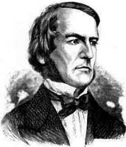
Propositional Logic (§1.1)
George Boole (1815-1864)
5
Propositional Logic is the logic of compound statements built from simpler statements using so-called Boolean connectives.
Some applications in computer science:
Design of digital electronic circuits.
Expressing conditions in programs.
Queries to databases & search engines.
Theorem proving.
Neural network architecture attribute
analysis.
Notes:
5
We normally attribute propositional logic to George Boole, who first formalized it. Actually the particular formal notation we will present is not precisely Boole’s; he originally spoke of logic in terms of sets, not propositions, and he also used Boolean algebra notation such as AB, A+B, rather than the A /\ B, A \/ B notation we will use. But, he was the first to mathematically formalize these kinds of concepts in preserved writings. Boole’s formalization of logic was developed further by the philosopher Frege.
However, even though logic was not formalized as such until the 1800’s, the basic ideas of it go all the way back to the ancient Greeks. Aristotle (ca. 384-322 B.C.) developed a detailed system of logic (though one that was not quite as convenient and powerful as the modern one), and Chrysippus of Soli (ca. 281-205 B.C.) introduced a logic centered around logic AND, inclusive and exclusive OR, NOT, and implication, similarly to Boole’s. Chrysippus’ logic apparently included all of the key rules that Boole’s logic had. However, his original works were unfortunately lost; we only have fragments quoted by other authors.

Slide 6
Propositions in natural language
In propositional logic, a proposition is simply:
a statement (i.e., a declarative sentence)
with some definite meaning
having a truth value that’s either true (T) or false (F)
Never both, or somewhere “in between”. However, you might not know the truth value
6

Slide 7
Examples of NL Propositions
7
“It is raining.” (In a given situation.)
“Beijing is the capital of China, and 1 + 2 = 2”
But, the following are NOT propositions:
“Who’s there?” (interrogative: no truth value)
“x := x+1” (imperative: no truth value)
“1 + 2” (term: no truth value)

Slide 8
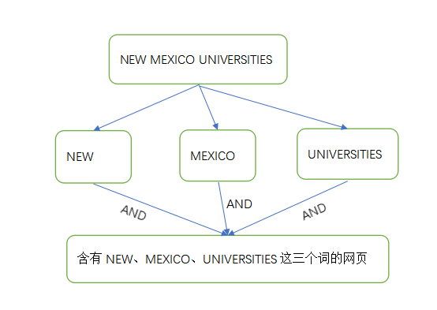
Example
逻辑联结词广泛应用于信息搜索中，因为搜索采用的是命题逻辑搜索的技术，所以一般上也称为布尔搜索。布尔搜索常常使用联结词AND、OR、NOT将语句拆分成一个或几个搜索项。
在搜索引擎中输入语句进行搜索，搜索引擎会将语句拆分成具有联结词的命题式子进行搜索：
8
Notes:
8

Slide 9
The Negation Operator
T :≡ True; F :≡ False
“:≡” means “is defined as”
Operand column
Result column
9
The unary negation operator “¬” (NOT) transforms a prop. into its negation.
E.g. If p = “I have black hair.”
then ¬p = “I do not have black hair.”
The truth table for NOT:

Slide 10
The Conjunction Operator
10
The binary conjunction operator “∧” (AND) combines two propositions to form their logical conjunction.
E.g. If p=“I will have noodle for lunch.” and q=“I will have fruit for dinner.”, then p∧q=“I will have noodle for lunch and I will have fruit for dinner.”

Slide 11
Conjunction Truth Table
Operand columns
11
Note that a conjunction p₁ ∧ p₂ ∧ … ∧ p_{n} of n propositions will have 2^{n} rows in its truth table.
Also: ¬ and ∧ operations together are sufficient to express any Boolean truth table!
Notes:
11
Note that AND is commutative and associative, which means that we can write a long conjunction (like in the first bullet on the left) without parenthesizing it. It also doesn’t matter what order the n propositions are in.
The fact that an n-operand operator has 2^n rows in its truth table is an easy consequence of the product rule of combinatorics. Here is a proof. Note that for the table to be complete, we must have 1 row for every possible assignment of truth values to the n operands. Thus, there is 1 row for every function f:V->B, where V is the set of operand columns {p,q,…} and B={T,F}. Here, |V|=n and |B|=2. The number of functions from a set of size n to a set of size m is m^n. This is because of the product rule, as we will see in a moment. In this case, m=2 so we get 2^n such functions. In terms of the product rule: There are 2 possible values for p. For each of these, there are 2 possible values for q, since the choice of q is independent of the choice of p. And so on. So there are 2x2x…(n repetitions)…x2 possible rows, thus 2^n. Of course, we haven’t defined the product rule, set cardinality, or functions yet, so don’t worry if the above argument doesn’t quite make sense to you yet.
In the second bullet, we would say, {NOT,AND} is a universal set of Boolean operators, but we haven’t even defined sets yet. If you already know what a set is, a universal set of operators over a given domain is a set of operators such that nested expressions involving those operators are sufficient to express any possible operator over that domain. In this case, the domain is B={T,F}. The proof that {NOT,AND} is universal is as follows: OR can be defined by p OR q = NOT(NOT(p) AND NOT(q)) (easily verified; this is one of DeMorgan’s Laws, which we will get to later). Now, armed with OR, AND, and NOT, we can show how to express any Boolean truth table, with any number of columns, as follows. Look for the cases where the last (result) column is T. For each such row in the truth table, include a corresponding term in a disjunctive expression for the whole truth table. The term should be a conjunction of terms, one for each input operand in that row. Each of these terms should be p if the entry in that position is “T”, and NOT(p) if the entry in that position is “F”. So, the entire expression basically says, “the value of the operator is T if and only if the pattern of truth values of the input operands exactly matches one of the rows in the truth table that ends in a ‘T’ result.” Thus, the expression directly encodes the content of the truth table.

Slide 12
The Disjunction Operator
The meaning is like “and/or” in English.
12
The binary disjunction operator “∨” (OR) combines two propositions to form their logical disjunction.
p=“My car has a bad engine.”
q=“My car has a bad carburetor.”
p∨q=“Either my car has a bad engine, or my car has a bad carburetor.”
Notes:
12
OR is also commutative and associative.
The animated picture on the right is just a memory device to help you remember that the disjunction operator is symbolized with a downward-pointing wedge, like the blade of an axe, because it “splits” a proposition into two parts, such that you can take either part (or both), if you are trying to decide how to make the whole proposition true.
Note that the meaning of disjunction is like the phrase “and/or” which is sometimes used in informal English. “The car has a bad engine and/or a bad carburetor.”

Slide 13
Disjunction Truth Table
Note that p∨q means that p is true, or q is true, or both are true!
So, this operation is also called inclusive or, because it includes the possibility that both p and q are true.
“¬” and “∨” together are also universal.
Note difference from AND
13

Slide 14
The Exclusive Or Operator
14
The binary exclusive-or operator “⊕” (XOR) combines two propositions to form their logical “exclusive or”.
p = “I will earn an A in this course,”
q = “I will drop this course,”
p ⊕ q = “I will either earn an A in this course, or I will drop it (but not both!)”

Slide 15
Exclusive-Or Truth Table
Note that p⊕q means that p is true, or q is true, but not both!
This operation is called exclusive or, because it excludes the possibility that both p and q are true.
“¬” and “⊕” together are not universal.
Note difference from OR.
15
Notes:
15
A good way to remember the symbol for XOR, a plus sign inside an O, is to think of XOR as adding the bit-values of its inputs (mod 2). E.g., 0+0=0, 1+0=0, 1+1=0 (mod 2). Thus XOR is basically an addition, and we put it inside an “O” to remind ourselves that it is a type of “Or”.
XOR together with unary operators do not form a universal set of operators over the Booleans. However, it turns out that they are a universal set for quantum logic! However we do not have time to cover quantum computing in this class, interesting though it is.

Slide 16
Test your understanding of the two types of disjunction
16
Suppose p ∨ q is true. Does it follow that p⊕q is true?
Suppose p⊕q is true. Does it follow that p ∨ q is true?

Slide 17
Test your understanding of the two types of disjunction
17
Suppose p ∨ q is true. Does it follow that p⊕q is true? No: consider p TRUE, q TRUE
Suppose p⊕q is true. Does it follow that p ∨ q is true? Yes. Check each of the two assignments that make p⊕q true: a) p TRUE, q FALSE (makes p ∨ q true) b) p FALSE, q TRUE (makes p ∨ q true)

Slide 18
Implications
18

Slide 19
The Implication Operator
antecedent
consequent
The implication p → q states that p implies q.
I.e., If p is true, then q is true; but if p is not true, then q could be either true or false.
E.g., let p = “You study hard.” q = “You will get a good grade.”
p → q = “If you study hard, then you will get a good grade.”
19
Notes:
19
Note that the definition of “p implies q” says: “If p is true, then q is true, and if p is not true, then q is either true or false.” Well, saying that q is either true or false is not saying anything, since any proposition is, by the very definition of a proposition, either true or false. So, the last part of that sentence (covering the case where p is not true) is not really saying anything. So we may as well say the definition is, “If p is true, then q is true.”
Sometimes the antecedent is called the hypothesis and the consequent is called the conclusion.

Slide 20
Implication Truth Table
The only False case!
20
p → q is false only when (p is true but q is not true)
p → q does not mean that p causes q!
p → q does not require that p or q are true!
E.g. “(1=0) → pigs can fly” is TRUE!
Notes:
20
Let’s consider the rows of the truth table, one at a time. In the first row, p is false and q is false. Now, let’s consider the definition of p->q. It says “If p is true, then q is true, but if p is false, then q is either true or false.” Well, in this case, p is false, and q is either true or false (namely false), so the second part of the statement is true. But, of course that part is true, since it is just a tautology that q is either true or false. In other words, and if is always true when its antecedent is false.
Similarly, the second row is True.
The third row is false, since p is true but q is false, so it is not the case that if p is true then q is true.
Finally, in the fourth row, since p is true and q is true, it is the case that if q is true then q is true.
Many students have trouble with the implication operator. When we say, “A implies B”, it is just a shorthand for “either not A, or B”. In other words, it is just the statement that it is NOT the case that A is true and B is false.
This often seems wrong to students, because when we say “A implies B” in everyday English, we mean that if somehow A were to become true in some way, somehow, the statement B would automatically be thereby made true, as a result. This does not seem to be the case in general when A and B are just two random false statements (such as the example in the last bullet). (However in this case, we might make a convoluted argument that the antecedent really DOES effectively imply the consequent: Note that if 1=0, then if a given pig flies 0 times in his life, then he also flies 1 time, thus he can fly.)
In any case, perhaps a more accurate and satisfying English rendering of the true meaning of the logical claim “A implies B”, might be just, “the possibility that A implies B is not contradicted directly by the truth values of A and B”. In other words, “it is not the case that A is true and B is false.” (Since that combination of truth values would directly contradict the hypothesis that A implies B.)

Slide 21
Implication Truth Table
21
Suppose you know that q is T. What do you know about p→q ?
The conditional must be T
Notes:
21
Let’s consider the rows of the truth table, one at a time. In the first row, p is false and q is false. Now, let’s consider the definition of p->q. It says “If p is true, then q is true, but if p is false, then q is either true or false.” Well, in this case, p is false, and q is either true or false (namely false), so the second part of the statement is true. But, of course that part is true, since it is just a tautology that q is either true or false. In other words, and if is always true when its antecedent is false.
Similarly, the second row is True.
The third row is false, since p is true but q is false, so it is not the case that if p is true then q is true.
Finally, in the fourth row, since p is true and q is true, it is the case that if q is true then q is true.
Many students have trouble with the implication operator. When we say, “A implies B”, it is just a shorthand for “either not A, or B”. In other words, it is just the statement that it is NOT the case that A is true and B is false.
This often seems wrong to students, because when we say “A implies B” in everyday English, we mean that if somehow A were to become true in some way, somehow, the statement B would automatically be thereby made true, as a result. This does not seem to be the case in general when A and B are just two random false statements (such as the example in the last bullet). (However in this case, we might make a convoluted argument that the antecedent really DOES effectively imply the consequent: Note that if 1=0, then if a given pig flies 0 times in his life, then he also flies 1 time, thus he can fly.)
In any case, perhaps a more accurate and satisfying English rendering of the true meaning of the logical claim “A implies B”, might be just, “the possibility that A implies B is not contradicted directly by the truth values of A and B”. In other words, “it is not the case that A is true and B is false.” (Since that combination of truth values would directly contradict the hypothesis that A implies B.)

Slide 22
Implication Truth Table
22
Suppose you know that p is F. What do you know about p→q ?
The conditional must be T
Notes:
22
Let’s consider the rows of the truth table, one at a time. In the first row, p is false and q is false. Now, let’s consider the definition of p->q. It says “If p is true, then q is true, but if p is false, then q is either true or false.” Well, in this case, p is false, and q is either true or false (namely false), so the second part of the statement is true. But, of course that part is true, since it is just a tautology that q is either true or false. In other words, and if is always true when its antecedent is false.
Similarly, the second row is True.
The third row is false, since p is true but q is false, so it is not the case that if p is true then q is true.
Finally, in the fourth row, since p is true and q is true, it is the case that if q is true then q is true.
Many students have trouble with the implication operator. When we say, “A implies B”, it is just a shorthand for “either not A, or B”. In other words, it is just the statement that it is NOT the case that A is true and B is false.
This often seems wrong to students, because when we say “A implies B” in everyday English, we mean that if somehow A were to become true in some way, somehow, the statement B would automatically be thereby made true, as a result. This does not seem to be the case in general when A and B are just two random false statements (such as the example in the last bullet). (However in this case, we might make a convoluted argument that the antecedent really DOES effectively imply the consequent: Note that if 1=0, then if a given pig flies 0 times in his life, then he also flies 1 time, thus he can fly.)
In any case, perhaps a more accurate and satisfying English rendering of the true meaning of the logical claim “A implies B”, might be just, “the possibility that A implies B is not contradicted directly by the truth values of A and B”. In other words, “it is not the case that A is true and B is false.” (Since that combination of truth values would directly contradict the hypothesis that A implies B.)

Slide 23
Implications between real sentencs
“If this lecture ever ends, then the sun has risen this morning.” True or False?
“If Tuesday is a day of the week, then I am Dehua Liu.” True or False?
“If 1+1=6, then a triangle has six sides.” True or False?
“If the moon is made of banana, then I am richer than Jiacheng Li.” True or False?
23
Notes:
23
The first one is true because T->T is True. It doesn’t matter that my lecture ending is not the cause of the sun rising tomorrow.
The second one is false for me, because although Tuesday is a day of the week, I am most certainly NOT a penguin. (But, if a penguin were to say this statement, then it would be true for him.)
The third one is true, because 1+1 is not equal to 6. F->T is True.
The last one is true, because the moon is not made of green cheese. F->F is True.
In other words, anything that’s false implies anything at all. p->q if p is false. Why? If p is false, then if p is true, then p is both false and true at the same time, and so truth and falsity are the same thing. So if q is false then q is true.

Slide 24
English Phrases Meaning p → q
“p implies q”
“if p, then q”
“if p, q”
“when p, q”
“whenever p, q”
“q if p”
“q when p”
“q whenever p”
“p only if q”
“p is sufficient for q”
“q is necessary for p”
“q follows from p”
“q is implied by p”
24

Slide 25
Contrapositive
25
Some terminology, for an implication p → q:
Its converse is: q → p.
Its contrapositive: ¬q → ¬ p.
Its Inverse: ¬ p → ¬ q.
Which of these two has/have the same meaning (express same truth function) as p → q? Prove it.
Notes:
25
Also, note that the converse and inverse of p->q also have the same meaning as each other.

Slide 26
26
Proving the equivalence of p → q and its contrapositive, using truth tables:

Slide 27
But we’re not studying English ..
27
Probably no two of these expressions have exactly the same meaning in English
For example, ‘I’ll go to the party if Mary goes’ can be interpreted as implying ‘I’ll only go to the party if Mary goes’ turning the sentence into a biconditional: I go IFF Mary goes

Slide 28
Biconditional Truth Table
p ↔ q means that p and q have the same truth value.
Note this truth table is the exact opposite of ⊕’s!
Thus, p ↔ q means ¬(p ⊕ q)
p ↔ q does not imply that p and q are true, or that either of them causes the other.
28
Notes:
28
Also, p IFF q is equivalent to (p -> q) /\ (q -> p). (“/\” being the AND wedge)

Slide 29
Consider ...
29
The truth of p ↔ q, where
p= Guangzhou is in China q= 2+2 =4 TRUE
p= Japan is not in Asia q= 2+2 =5 TRUE
p= Scotland is in the UK q= Wales is not in the UK FALSE

Slide 30
Some Popular Boolean Operators
Formal Name | Nickname | Arity | Symbol
Negation operator | NOT | Unary | ¬
Conjunction operator | AND | Binary | ∧
Disjunction operator | OR | Binary | ∨
Exclusive-OR operator | XOR | Binary | ⊕
Implication operator | IMPLIES | Binary | →
Biconditional operator | IFF | Binary | ↔
30

Slide 31
Precedence of Logical Operators
31

Slide 32
Boolean Operations Summary
We have seen 1 unary operator (out of the 4 possible ones) and 5 binary operators:
32
Notes:
32
For fun, try writing down the truth tables for each of the 4 possible unary operators, and each of the 16 possible binary operators. For each one, try to come up with an English description of the operator that conveys its meaning. Also, figure out a way to define it in terms of other operators we already introduced.

Slide 33
Precedence of Logical Operators
↔
→
∨ ⊕
First Direction
∧
¬
33

Slide 34
Some Alternative Notations
34

Slide 35
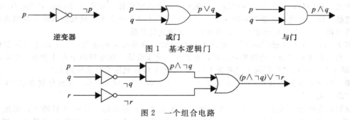
Example
谓词逻辑应用于计算机硬件的设计上，这个思想是1938年克劳德·香农（Claude Shannon）首次发表在他的MIT硕士论文中。
逻辑电路（或数字电路）接受输入信号p1,p2,……, pn，每个信号1位[或0(关)或1(开)]，产生输出信号s1,s2,……,sn，每个一位。复杂的数字电路都是由三种简单的基本电路构成（门电路）
35
Notes:
35

Slide 36
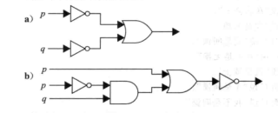
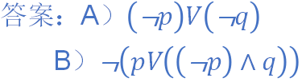
Example 5：语言处理的语句
在逻辑电路中，谓词逻辑公式常常用来表示电路的输出。请找出以下两个组合电路的输出结果：
36

Slide 37
Example 6: Logic and Bit Operations
XOR
1010101011
0100010100
0110110110
1100011101
AND
OR
1110111111
37

Slide 38
Translations
38

Slide 39
Example 1
“I just saw my old friend, and either he’s grown or I’ve shrunk.”
Solution:
Let f represent “I just saw my old friend”.
Let g represent “he’s grown ”.
Let s represent “I’ve shrunk”.
The sentence can be represented as f ∧ (g ∨ s).
(f ∧ g) ∨ s would mean something different.
f ∧ g ∨ s would be ambiguous.
39
Notes:
39
As an exercise, drop the truth tables for f /\ (g \/ s) and (f /\ g) \/ s to see that they’re different, and thus the parentheses are necessary.
Precedence conventions such as the one in the second bullet help to reduce the number of parentheses needed in expressions. Note that negation, with its tight binding (high precedence), and with its position to the left of its operand, behaves similarly to a negative sign in arithmetic.
There is also a precedence convention that you see sometimes (for example, in the C programming language) that AND takes precedence over OR. However, this convention is not quite universally accepted, not all systems adopt it. Therefore, to be safe, you should always include parentheses whenever you are mixing ANDs and ORs in a single sequence of binary operators.

Slide 40
Example 2
“Either the lawn wasn’t wet this morning, or it rained last night, or the sprinklers came on last night.”
40
Solution:
Let r =“The lawn was wet this morning”,
p =“It rained last night”, q =“The sprinklers came on last night”.
Thus, ¬p = “It didn’t rain last night.”
r ∧ ¬p = “The lawn was wet this morning, and it didn’t rain last night.”
The sentence can be represented as ¬ r ∨ p ∨ q
Notes:
40
For slides that have interactive exercises, it may be a good idea to stop the class for a minute to allow the students to discuss the problem with their neighbors, then call on someone to answer. This will help keep the students engaged in the lecture activity.

Slide 41
Example 3
41
Express the specification “The automated reply cannot be sent when the file system is full” using logical connectives.
Solution:
Let p denote “The automated reply can be sent ”,
and q denote “the file system is full”.
The sentence can be represented as
q → ¬p

Slide 42
Example 4：语言处理的语句
自 然语 言
命题变量及逻辑联结词分析
复 合命 题
42
计算机不能够处理中文语言处理，对自然语言进行处理时必须先将语句转为符号化才能利用计算机进行进一步处理操作，语句可以表示成由命题变量和逻辑联结词组成的表达式，把语句翻译成复合命题，这样翻译时需要根据语句的含义做一些合理的假设，一旦完成了从语句到逻辑表达式的翻译，我们就能够反洗这些逻辑表达式以确定它们的真值来继续对它们进行语言处理的其它操作。

Slide 43
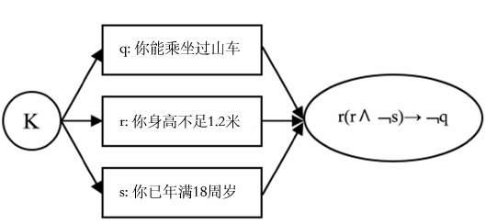
Example 5：语言处理的语句
自然语言案例K：“如果你身高不足1.2米，那么你不能乘坐过山车，除非你已年满18周岁”。
43

Slide 44
Application
44

Slide 45
Example 1: Logic Puzzle
Knight
Knave
Tell the truth
Lie
A: ”B is a Knight”
B: ”The two of us are opposite types”
A
B
A
B
A
B
A
B
45

Slide 46
Example 2: Muddy Forehead Children
Boy’s answer
Girl’s answer
Father
No
No
Yes
Yes
At least one of you has a muddy forehead.
Do you know whether you have a muddy forehead?
Do you know whether you have a muddy forehead?
46

Slide 47
比赛名次预测
三人估计比赛结果，
甲说“A第一，B第二”。
乙说“C第二，D第四”。
丙说“A第二，D第四”。
结果三人的预测都只对了一半，请问A,B,C,D的比赛名次。
47

Slide 48
比赛名次预测
三人估计比赛结果，
甲说“A第一，B第二”。
乙说“C第二，D第四”。
丙说“A第二，D第四”。
结果三人的预测都只对了一半，请问A,B,C,D的比赛名次。
构造真值表来表示三人的预测结果，理论上真值表总共有2*2*2=8行（每个人的预测结果是TF或FT）。
比赛的名次（从第一到第四）是C,B,A,D，每个人的预测都错了前一半，对了后一半。
48

Slide 49
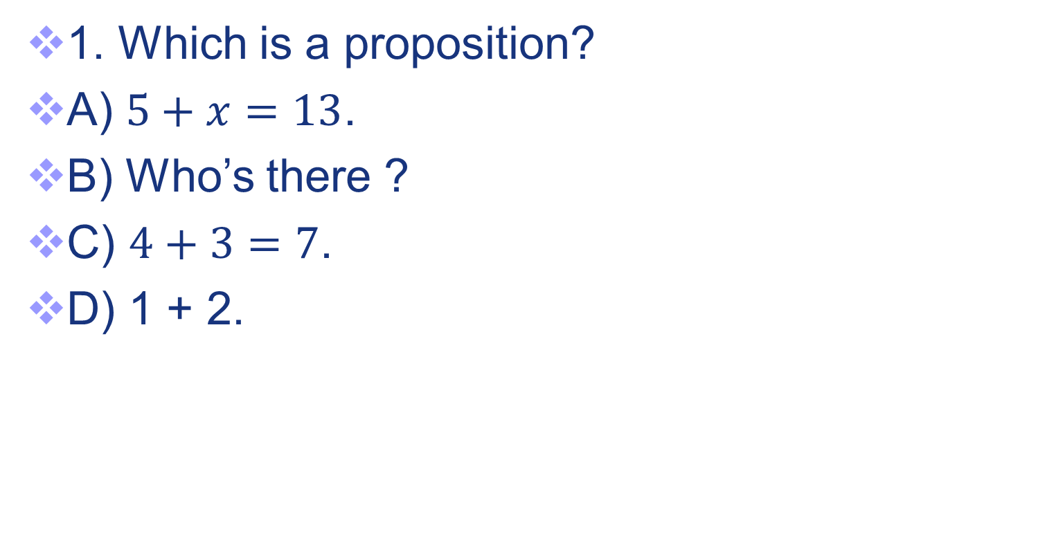
Exercises
49

Slide 50
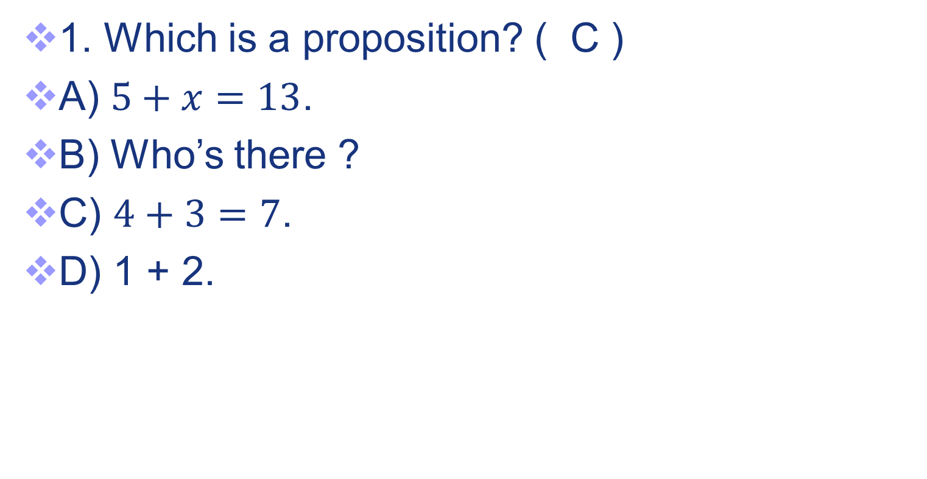
Exercises
50

Slide 51
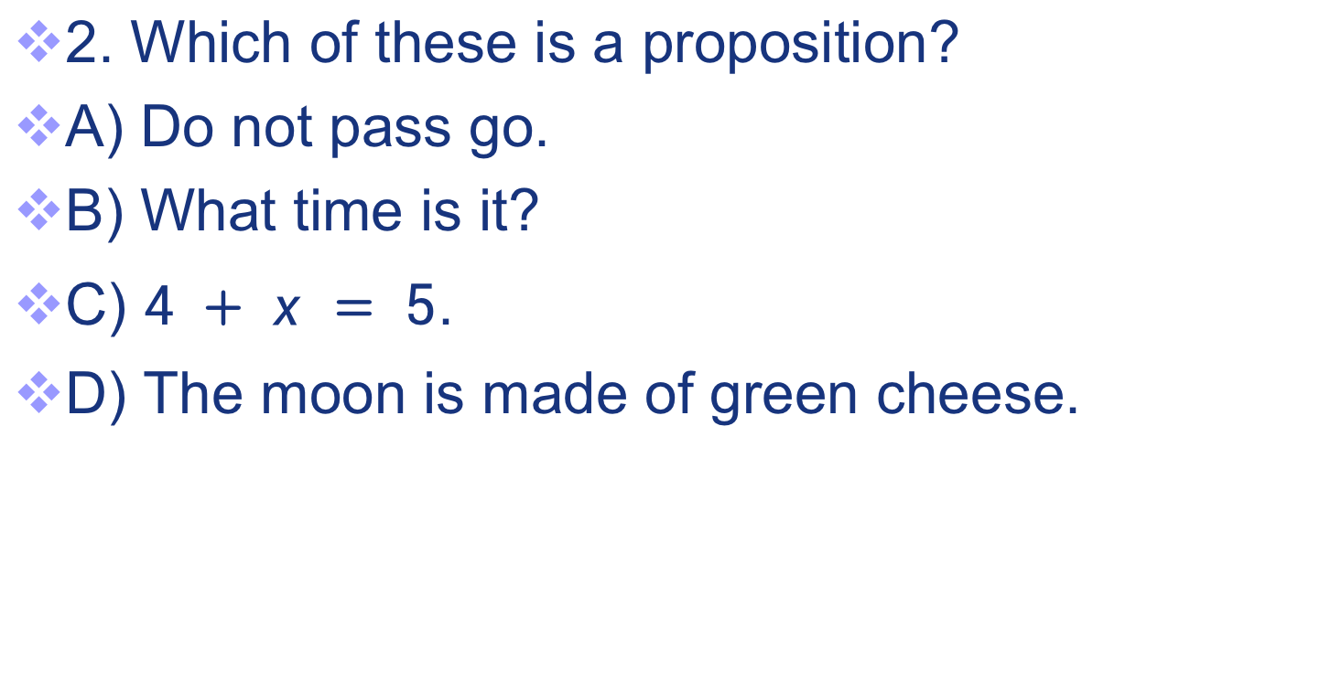
Exercises
2. Which of these is a proposition?
A) Do not pass go.
B) What time is it?
C) $4 + x = 5$.
D) The moon is made of green cheese.
51

Slide 52
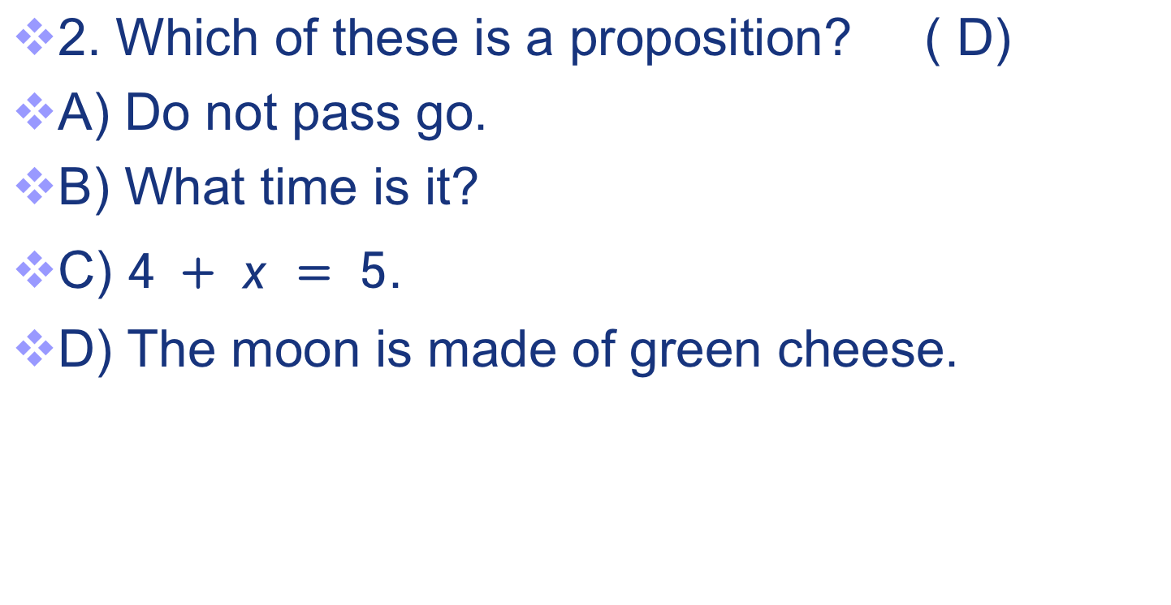
Exercises
2. Which of these is a proposition? ( D)
A) Do not pass go.
B) What time is it?
C) $4 + x = 5$.
D) The moon is made of green cheese.
52

Slide 53
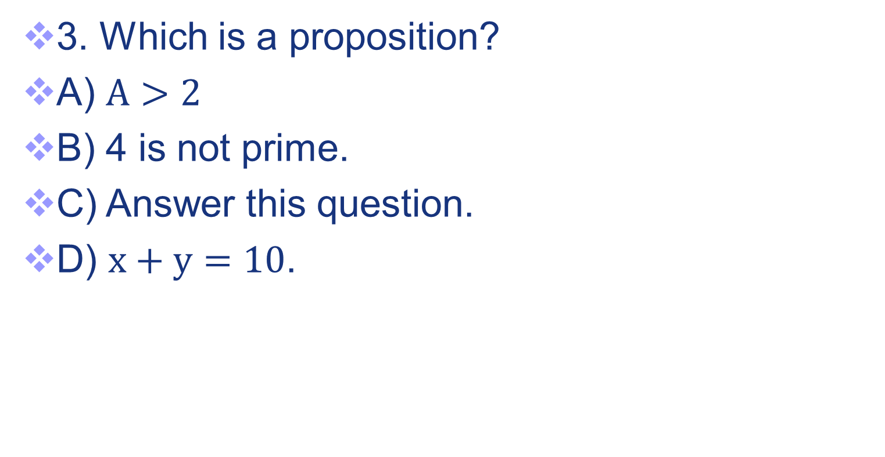
Exercises
53

Slide 54
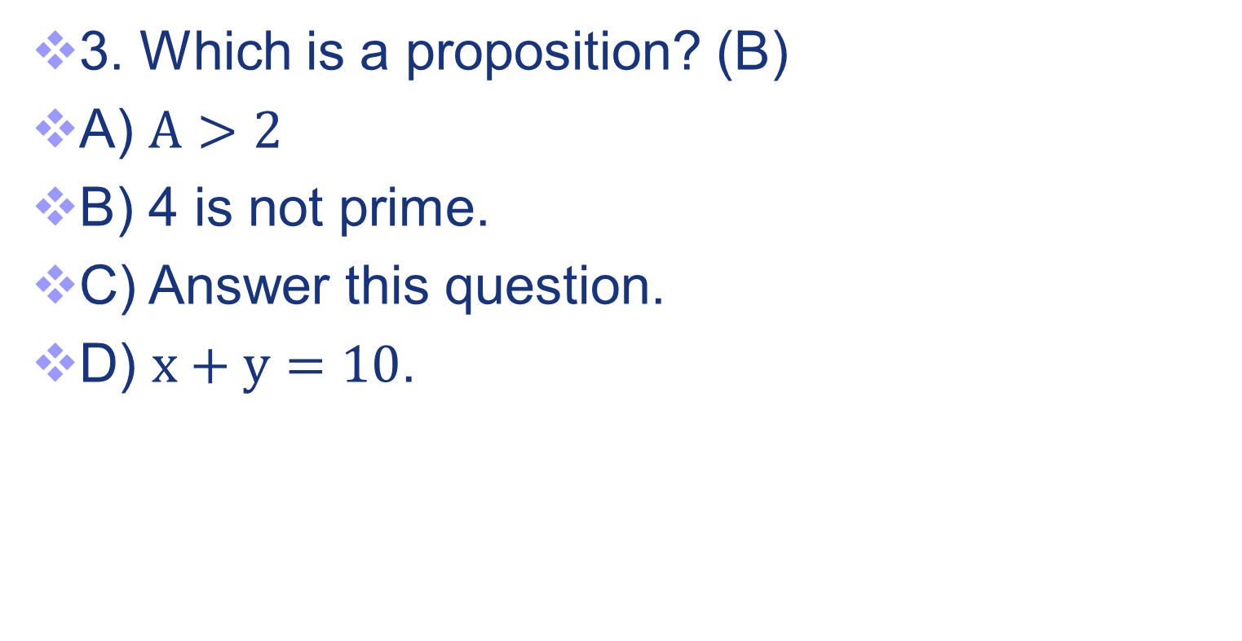
Exercises
54

Slide 55
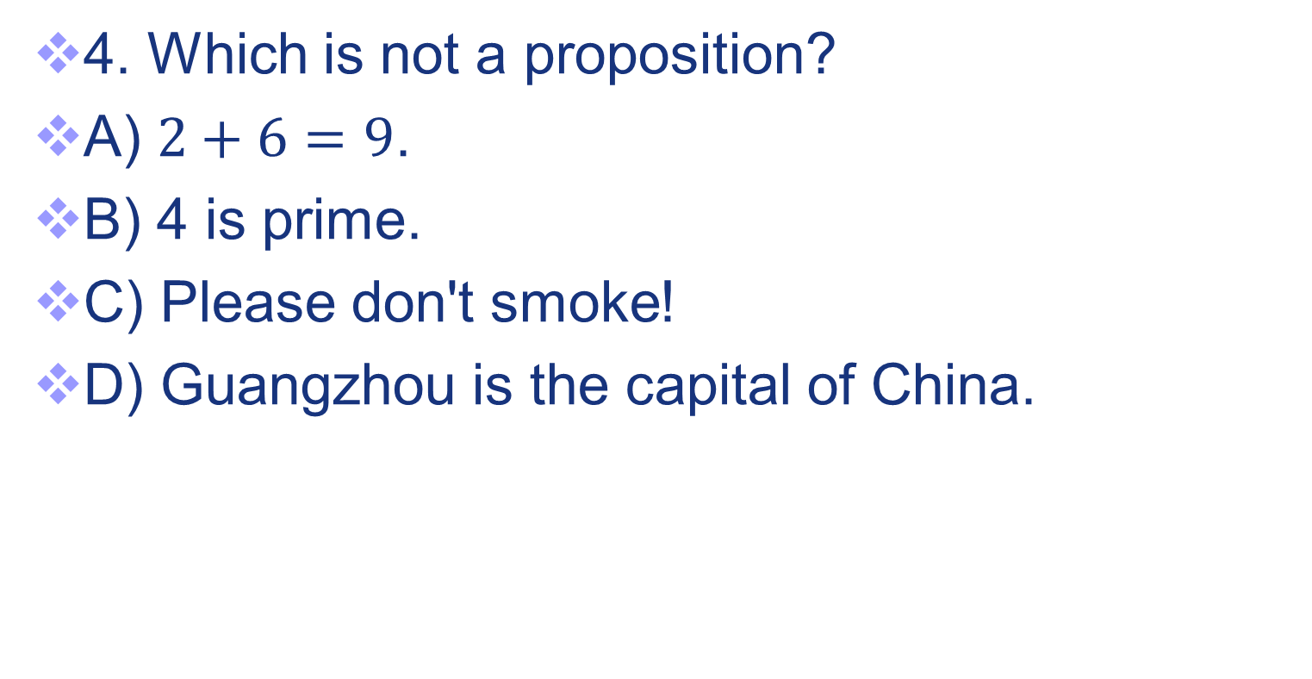
Exercises
55

Slide 56
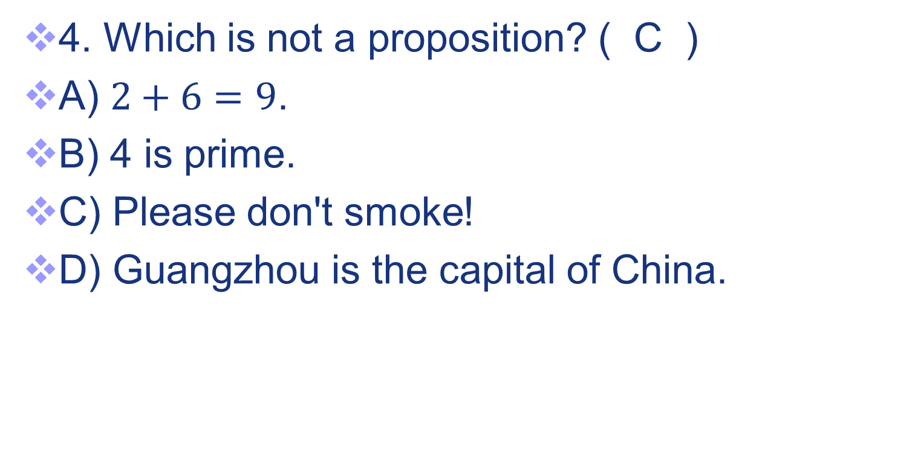
Exercises
56

Slide 57
Exercises
5. Which of the following is not a proposition?
A. It is snowing.
B. An even number can be expressed as the sum of two prime numbers.
C. Pass the course.
D. If 1+100=100, then the sun rises in the west.
57

Slide 58
Exercises
5. Which of the following is not a proposition?
(C)
A. It is snowing.
B. An even number can be expressed as the sum of two prime numbers.
C. Pass the course.
D. If 1+100=100, then the sun rises in the west.
58

Slide 59
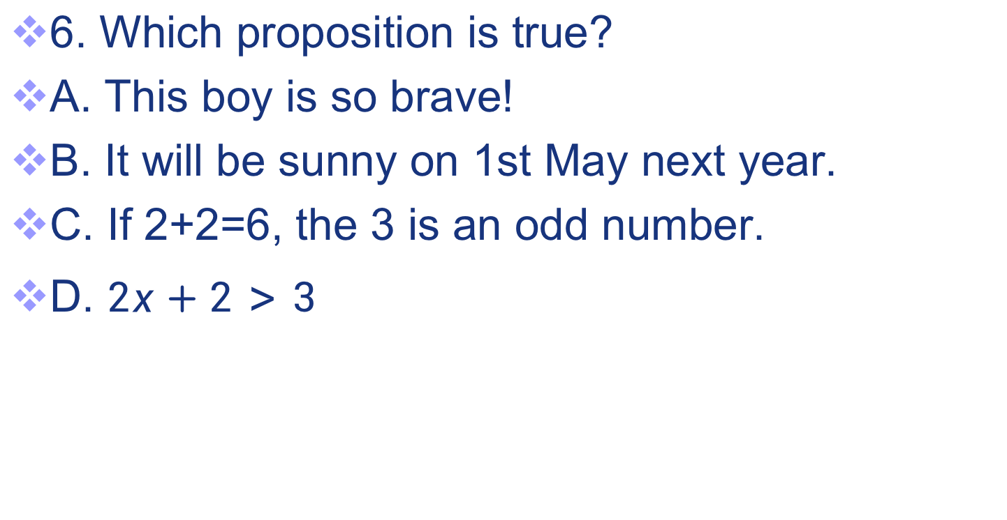
Exercises
6. Which proposition is true?
A. This boy is so brave!
B. It will be sunny on 1st May next year.
C. If 2+2=6, the 3 is an odd number.
D. $2x+2>3$
59

Slide 60
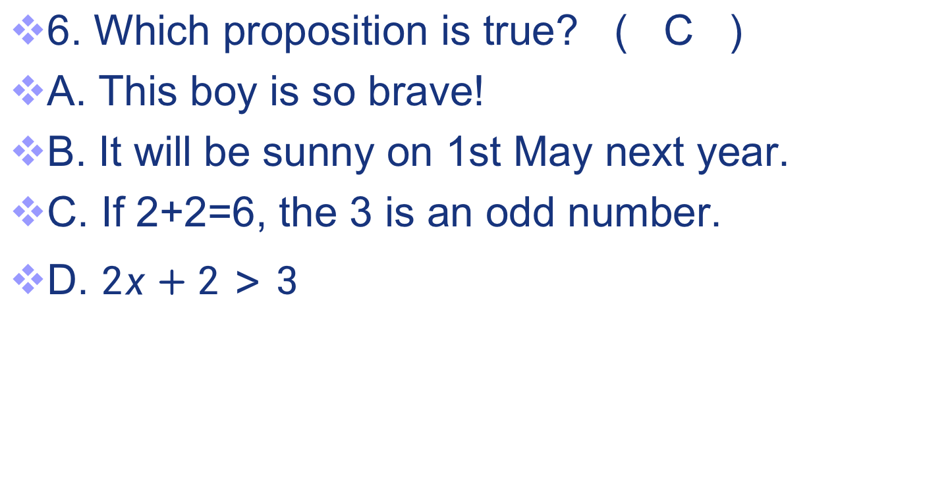
Exercises
6. Which proposition is true? ( C )
A. This boy is so brave!
B. It will be sunny on 1st May next year.
C. If 2+2=6, the 3 is an odd number.
D. $2x+2>3$
60

Slide 61
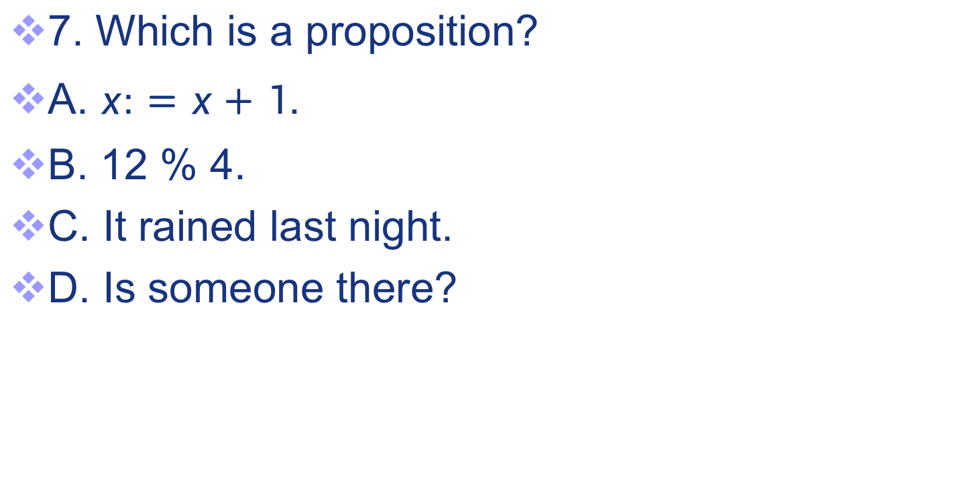
Exercises
7. Which is a proposition?
A. $x:=x+1$.
B. 12 % 4.
C. It rained last night.
D. Is someone there?
61

Slide 62
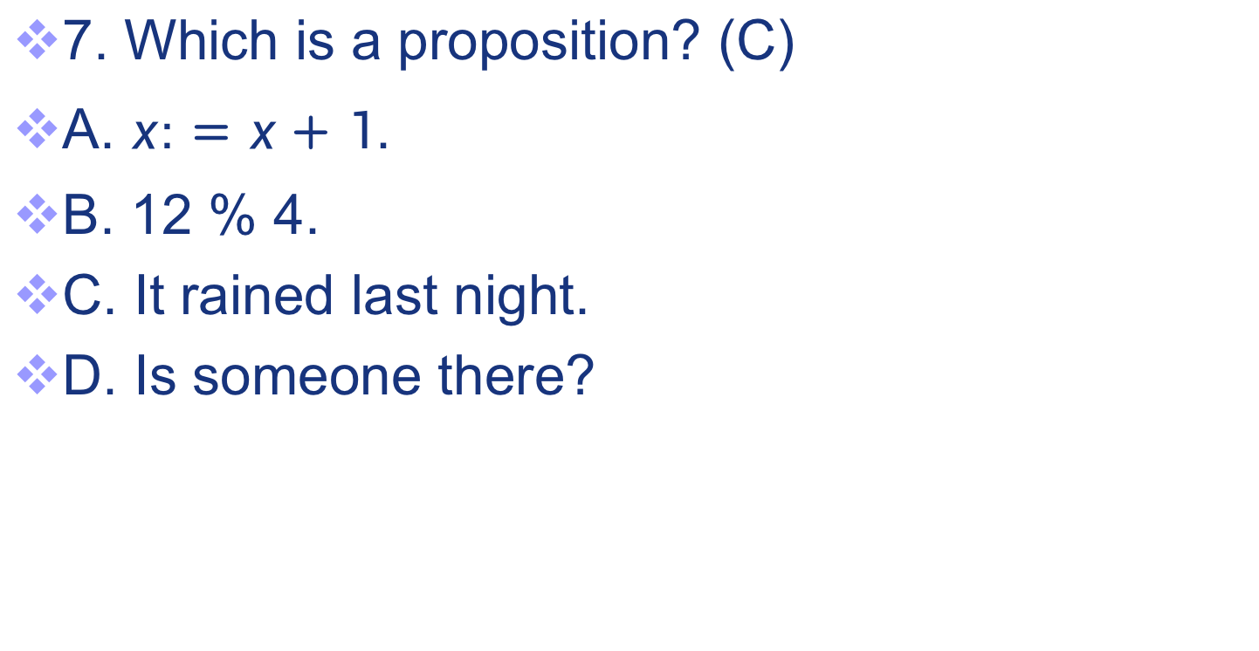
Exercises
7. Which is a proposition? (C)
A. $x:=x+1$.
B. 12 % 4.
C. It rained last night.
D. Is someone there?
62

Slide 63
Exercises
8. Which is a proposition?
A. Beijing is the capital of China, and 1+2=2.
B. p = p / 2.
C. O(n log n)
D. Who’s there?
63

Slide 64
Exercises
8. Which is a proposition? ( A )
A. Beijing is the capital of China, and 1+2=2.
B. p = p / 2.
C. O(n log n)
D. Who’s there?
64

Slide 65
Exercises
9. Which is a true proposition?
A) If 3+2=8, the Shenzhen will be the capital of Guangdong province.
B) 28 % 4.
C) I am sleeping.
D) This cat is so cute!
65

Slide 66
Exercises
9. Which is a true proposition? ( A )
A) If 3+2=8, the Shenzhen will be the capital of Guangdong province.
B) 28 % 4.
C) I am sleeping.
D) This cat is so cute!
66

Slide 67
Exercises
10. Which is not a proposition?
A) 3 + 7 = 10.
B) Please be quiet!
C) 4 is odd.
D) Guangzhou is the capital of Guangdong province.
67

Slide 68
Exercises
10. Which is not a proposition? ( B )
A) 3 + 7 = 10.
B) Please be quiet!
C) 4 is odd.
D) Guangzhou is the capital of Guangdong province.
68

Slide 69
Exercises
11. Which is a proposition?
A. x > 1.5
B. Is the water boiling?
C. There will be no water on the earth after 5000 years.
D. The sentence is wrong.
69

Slide 70
Exercises
11. Which is a proposition? ( C )
A. x > 1.5
B. Is the water boiling?
C. There will be no water on the earth after 5000 years.
D. The sentence is wrong.
70

Slide 71
Exercises
12. Which is a proposition?
A. 4+x=5
B. Boston is the capital of Massachusetts.
C. What time is it?
D. Answer this question.
71

Slide 72
Exercises
12. Which is a proposition? ( B )
A. 4+x=5
B. Boston is the capital of Massachusetts.
C. What time is it?
D. Answer this question.
72

Slide 73
Exercises
13. Which of these sentences are propositions?
A）Do not pass go.
B）y+2=11
C) There are no black flies in Maine.
D) What time is it?
73

Slide 74
Exercises
13. Which of these sentences are propositions? （ C ）
A）Do not pass go.
B）y+2=11
C) There are no black flies in Maine.
D) What time is it?
74

Slide 75
Exercises
14. Which is a proposition?
A) My father loves me.
B) Take care.
C) xy=1
D) What time is it?
75

Slide 76
Exercises
14. Which is a proposition? ( A )
A) My father loves me.
B) Take care.
C) xy=1
D) What time is it?
76

Slide 77
Exercises
15. Which proposition is true?
A) I’m lying.
B) If 1+1=2, the sun will rise in the west.
C) If 1+1=3, the sun will rise in the west.
D) Did you have dinner yet?
77

Slide 78
Exercises
15. Which proposition is true? ( C )
A) I’m lying.
B) If 1+1=2, the sun will rise in the west.
C) If 1+1=3, the sun will rise in the west.
D) Did you have dinner yet?
78

Slide 79
Exercises
16. Which of these conditional statements is NOT true.
a) If 1 + 1 = 2, then 2 + 2 = 5.
b) If 1 + 1 = 3, then 2 + 2 = 4.
c) If 1 + 1 = 3, then 2 + 2 = 5.
d) If monkeys can fly, then 1 + 1 = 3.
79

Slide 80
Exercises
16. Which of these conditional statements is NOT true. ( A )
a) If 1 + 1 = 2, then 2 + 2 = 5.
b) If 1 + 1 = 3, then 2 + 2 = 4.
c) If 1 + 1 = 3, then 2 + 2 = 5.
d) If monkeys can fly, then 1 + 1 = 3.
80

Slide 81
Exercises
17. Which proposition is false.
a) If 1+100=100 or 1+2=3, a triangle has three sides.
b) If 1+100=101 and 1+2=3, a triangle has three sides.
c) If 1+100=100 and 1+2=3, a triangle has four sides.
d) If 1+100=101 and 1+2=3, a triangle has four sides.
81

Slide 82
Exercises
17. Which proposition is false. (D)
a) If 1+100=100 or 1+2=3, a triangle has three sides.
b) If 1+100=101 and 1+2=3, a triangle has three sides.
c) If 1+100=100 and 1+2=3, a triangle has four sides.
d) If 1+100=101 and 1+2=3, a triangle has four sides.
82

Slide 83
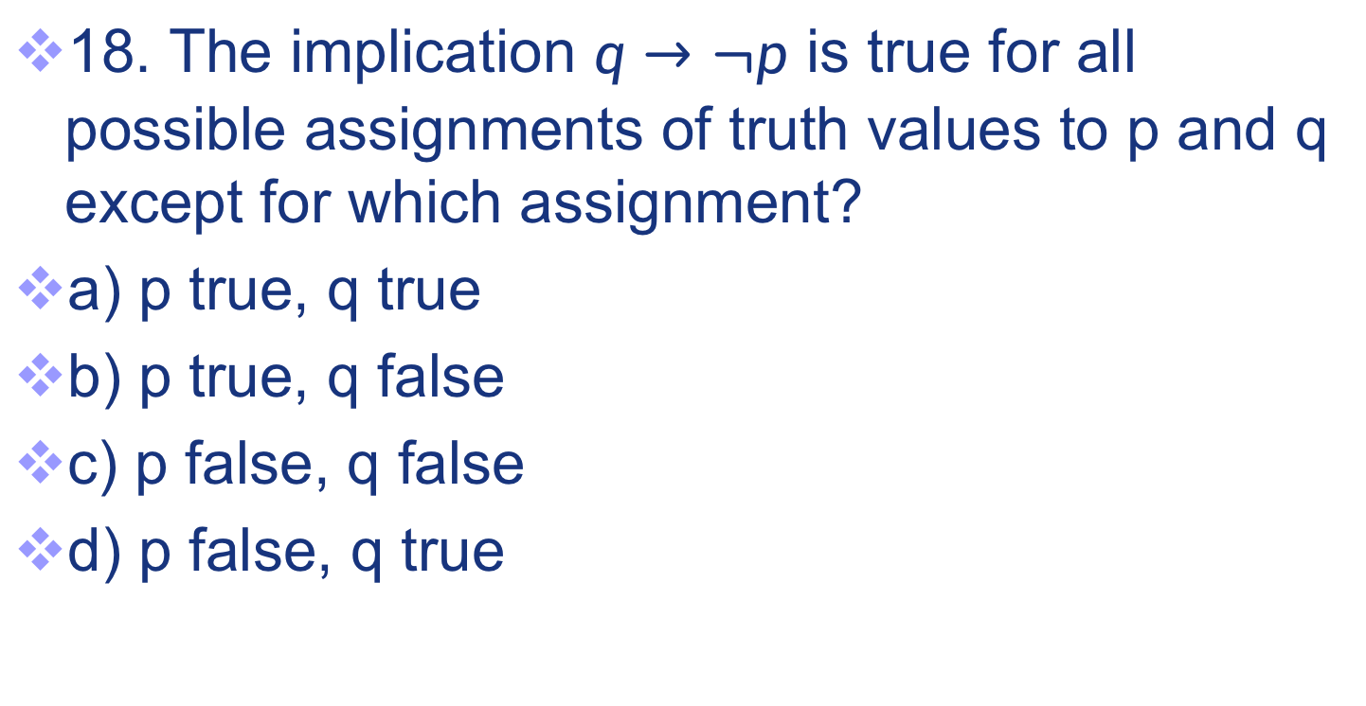
Exercises
18. The implication $q→¬p$ is true for all possible assignments of truth values to p and q except for which assignment?
a) p true, q true
b) p true, q false
c) p false, q false
d) p false, q true
83

Slide 84
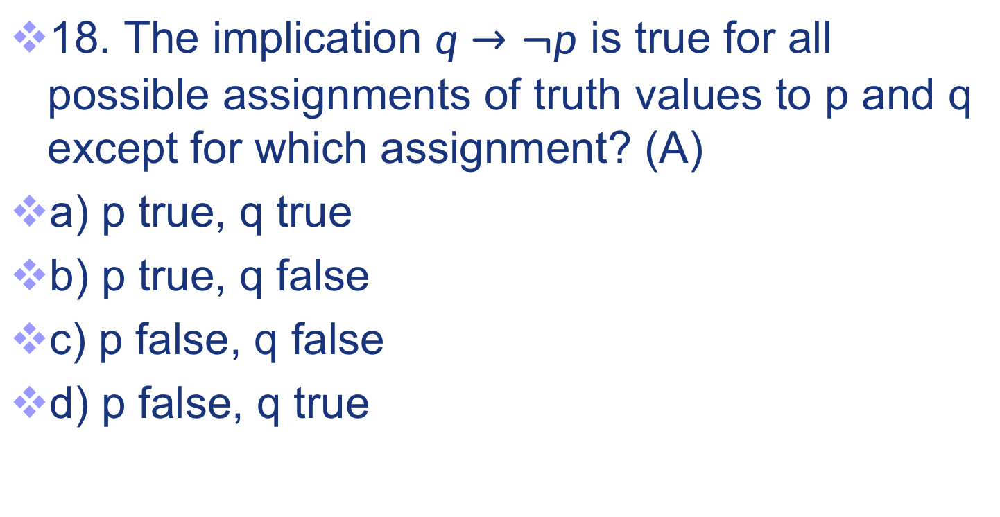
Exercises
18. The implication $q→¬p$ is true for all possible assignments of truth values to p and q except for which assignment? (A)
a) p true, q true
b) p true, q false
c) p false, q false
d) p false, q true
84

Slide 85
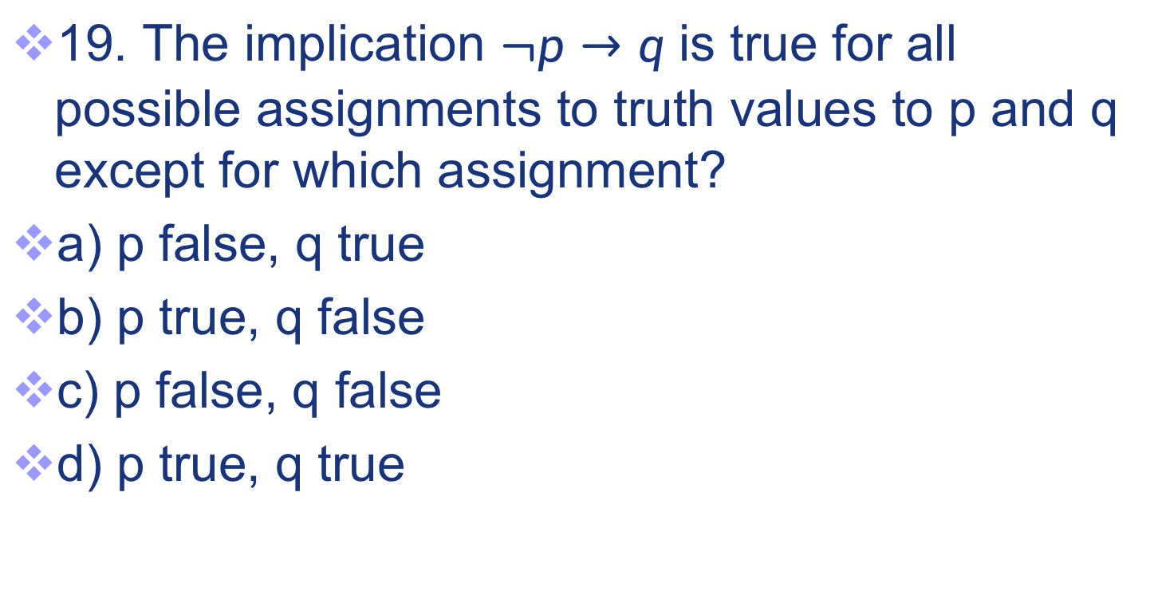
Exercises
19. The implication $¬p→q$ is true for all possible assignments to truth values to p and q except for which assignment?
a) p false, q true
b) p true, q false
c) p false, q false
d) p true, q true
85

Slide 86
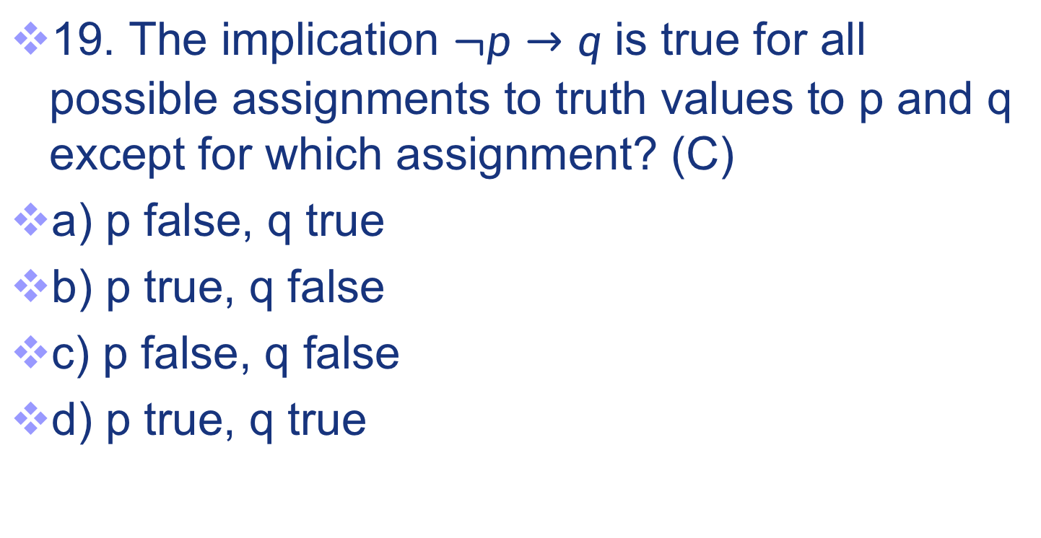
Exercises
19. The implication $¬p→q$ is true for all possible assignments to truth values to p and q except for which assignment? (C)
a) p false, q true
b) p true, q false
c) p false, q false
d) p true, q true
86

Slide 87
Exercises
20. Which of the following is NOT a proposition?
a) 4 is even.
b) Beijing is the capital of China.
c) Please don’t smoke!
d) 2+2=3.
87

Slide 88
Exercises
20. Which of the following is NOT a proposition?（C）
a) 4 is even.
b) Beijing is the capital of China.
c) Please don’t smoke!
d) 2+2=3.
88

Slide 89
Exercises
21. Which of the following is a proposition?
A) Please wear a mask.
B) x:=x+1.
C) 1+2.
D) If 1+100=100, then 2+2=4.
89

Slide 90
Exercises
21. Which of the following is a proposition? (D)
A) Please wear a mask.
B) x:=x+1.
C) 1+2.
D) If 1+100=100, then 2+2=4.
90

Slide 91
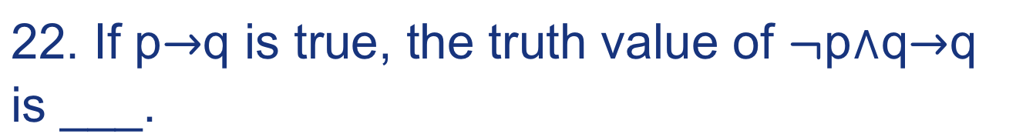
Exercises
22. If p$→$q is true, the truth value of $¬$p$∧$q$→$q
is ___.
91

Slide 92
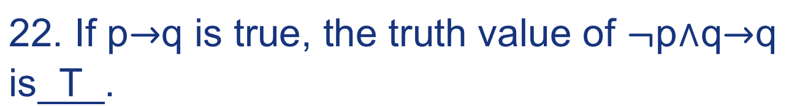
Exercises
22. If p$→$q is true, the truth value of $¬$p$∧$q$→$q
is T .
92

Slide 93
Exercises
23. Translate the protocol piece
“The router can send packets to the edge system only if it supports the new address space” considering P as “the router can send packets to the edge system” and Q as “the router supports the new address space”
93

Slide 94
Exercises
23. Translate the protocol piece
“The router can send packets to the edge system only if it supports the new address space” considering P as “the router can send packets to the edge system” and Q as “the router supports the new address space”
P->Q
94

Slide 95
Exercises
24. ( p ∧ q ) → p ∨ q is true or false?
95

Slide 96
Exercises
24. ( p ∧ q ) → p ∨ q is true or false?
T
96

Slide 97
Exercises
25. Translate the proverb “Either publish or perish, (but not both!)” considering P as “publish” and Q as “perish”
97

Slide 98
Exercises
25. Translate the proverb “Either publish or perish, (but not both!)” considering P as “publish” and Q as “perish”
P⊕Q
98

Slide 99
Exercises
26. Let l be Lois works late, let j be John works late, and let e be they will eat at home. Consider the proposition If Lois or John do not work late, then they will eat at home. Which of these represents the proposition in symbols?
A. ¬(l∨j)→e
B. (¬l∧¬j)→ ¬e
C. ¬(l∧j)→e
D. e →(¬l∧¬j)
99

Slide 100
Exercises
26. Let l be Lois works late, let j be John works late, and let e be they will eat at home. Consider the proposition If Lois or John do not work late, then they will eat at home. Which of these represents the proposition in symbols?
（C）
A. ¬(l∨j)→e
B. (¬l∧¬j)→ ¬e
C. ¬(l∧j)→e
D. e →(¬l∧¬j)
100

Slide 101
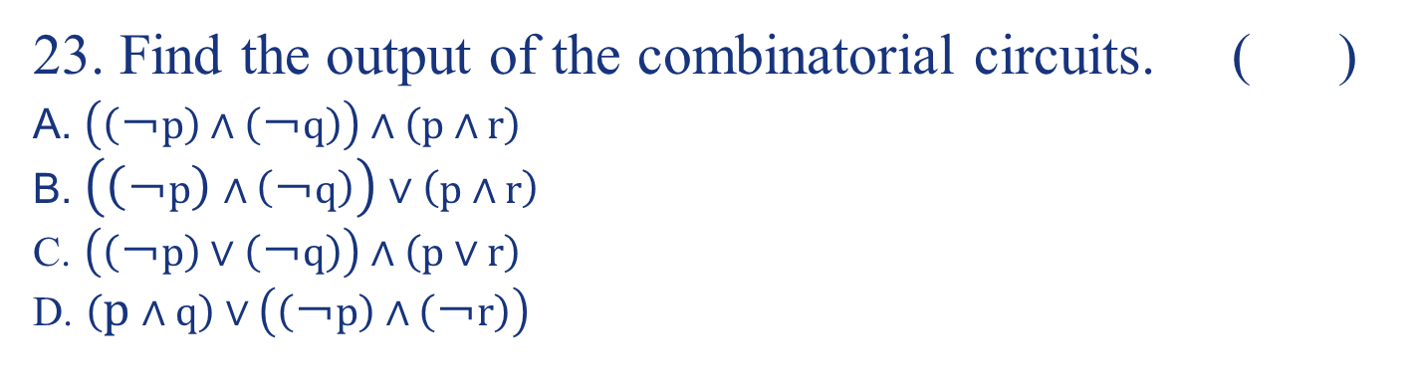
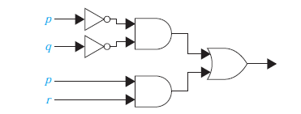
Exercises
27.
B
101

Slide 102
Exercises
28. What is the propositional logic notation corresponding to the condition operation “&&” in the programming language of C/C++/Java ?
102

Slide 103
Exercises
28. What is the propositional logic notation corresponding to the condition operation “&&” in the programming language of C/C++/Java ?
∧
103

Slide 104
Exercises
29. What is the propositional logic notation corresponding to the condition operation “||” in the programming language of C/C++/Java ?
104

Slide 105
Exercises
29. What is the propositional logic notation corresponding to the condition operation “||” in the programming language of C/C++/Java ?
disjunction OR (∨)
105

Slide 106
Exercises
30. The precedence of logical operators “⊕ ↔ ¬ →∧ ”
106

Slide 107
Exercises
30. The precedence of logical operators “⊕ ↔ ¬ →∧ ”
¬ ∧ ⊕ → ↔
107

Slide 108
End of the 1.1 Logic
Click to edit company slogan .
108

